Slide 1
Using Adobe XD as UI/UX development tool
Jari Isohanni, Centria University of Applied Sciences

Slide 2
How course is build up
Course is mix of slides and videos
Slides and videos slightly overlap, so watching videos is not neccessary
During course you build and publish first prototype.
Latest course material can be downloaded from: https://github.com/jariisohanni/Fundamentals-of-AdobeXD

Slide 3
Learning objective
Basics usage of Adobe XD
Using of images and other graphics and their copyrights
Publishing prototypes and collecting feedback

Slide 4
Exercise
To pass course you need to build your own prototype, publish it and send link to course teacher
Excercise subjects can be chosen freely, but some suggestions are:
Food order application
Information sharing for communities
Customer feedback for stores
Peer-to-Peer money transfer
Your prototype should include 5-7 pages and can be meant to work either mobile / web or some other (smart watch, etc..) device

Slide 5
Whats Adobe XD?
With Adobe XD you can:
Design User Interfaces
Implement functional prototype
Share prototype with customer for feedback
Adobe XD can be used with Adobe account for free, but with free account you can only publish one prototype for customers.

Slide 6
Download Adobe XD
First go to:
https://www.adobe.com/fi/products/xd.html
And choose ”Download”, you might need to create Adobe account if you don’t have one.
Once download is completed install Adobe as any software to your operating system.

Slide 7
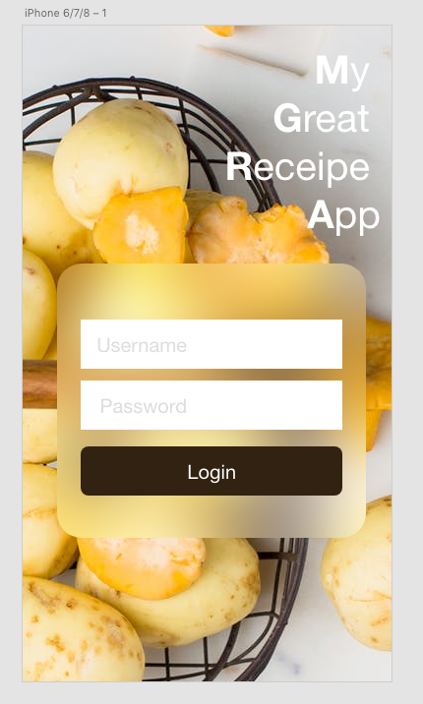
Design User Interfaces
On Adobe XD you can create user interfaces for any kind of device: mobile phones, tablets, desktop, etc…
User interfaces can be build from multiple components like images, text, vector grahics, etc…

Slide 8
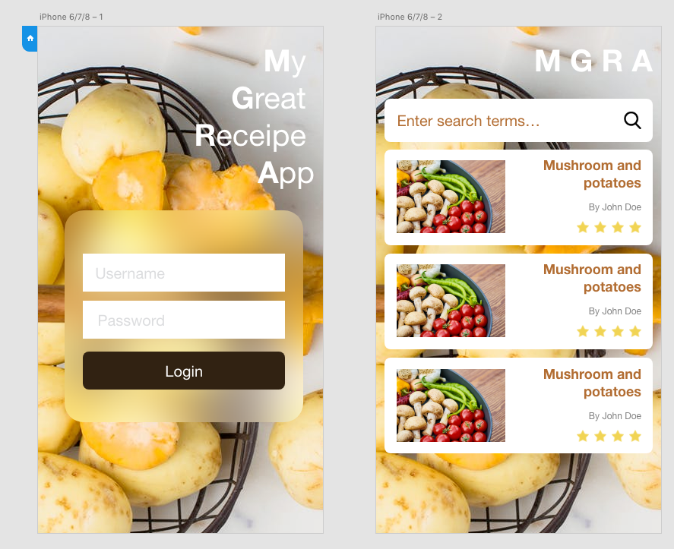
Implement functional prototype
With prototyping you can create functional prototypes that users are able to use just like final application, but without real data
Prototypes can contain unlimited amount of ”pages” and users are able interact with components
Interaction altough is quite limited

Slide 9
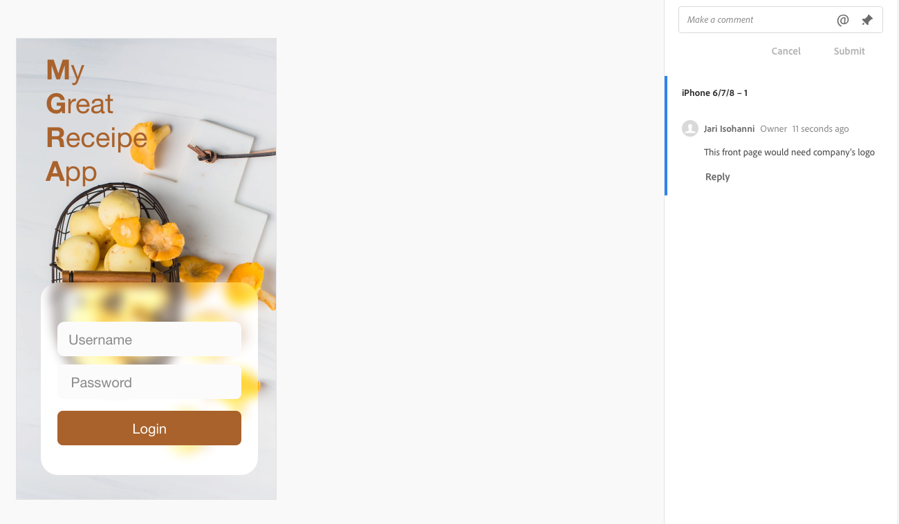
Sharing protypes
You can share prototype as public or password protected link
Users are able to open link in browser or Adobe XD mobile app
When users test your prototype they can give comments

Slide 10
Sharing protypes
Checkout this prototype with your desktop browser and mobile device
Make sure you leave some comments.
https://xd.adobe.com/view/96ef577f-4cfa-440d-59b8-518264fbb33f-e0de/

Slide 11
Lesson 1 my first page

Slide 12
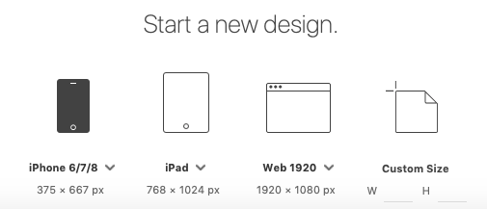
Creating a empty project
To create new project choose:
File -> New (or if you started Adobe XD you can just choose design size)
In learning materials we use iPhone 6/7/8 Plus
Select design size

Slide 13
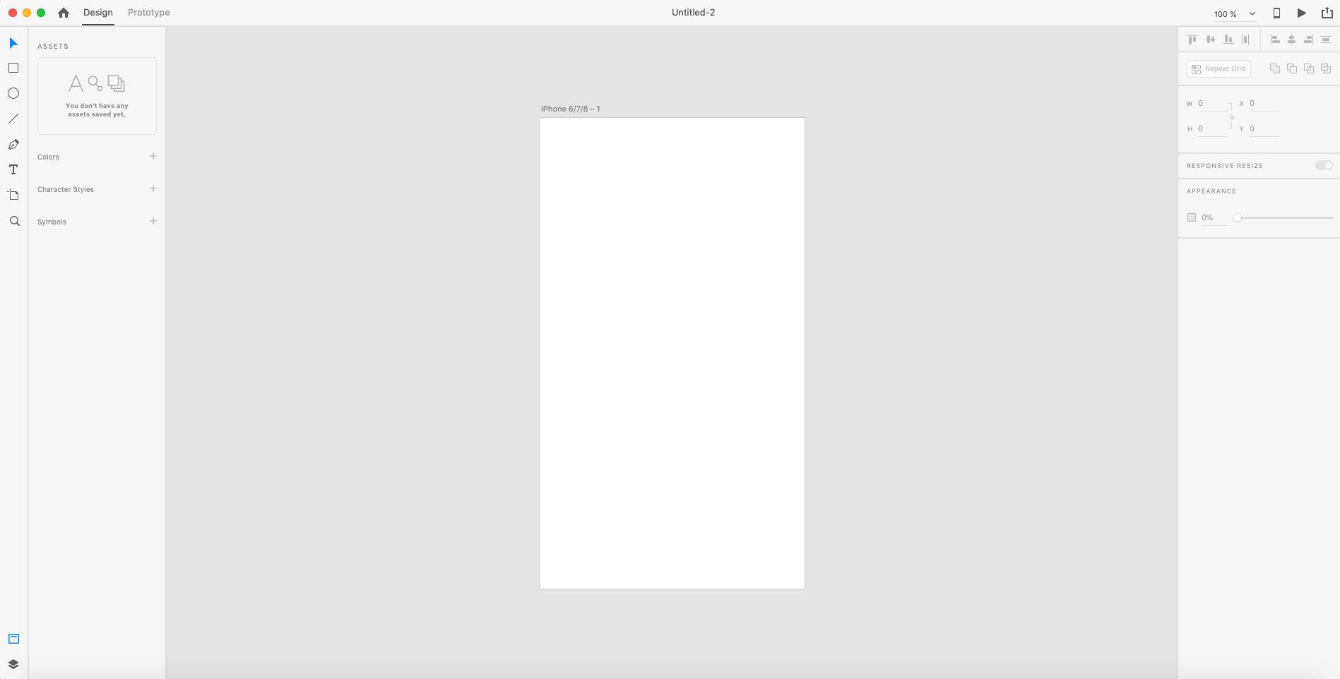
Creating a empty project
Empty project looks like this

Slide 14
Creating a empty project
From top menu you can change between Design / Prototype
Tools
Object properties pane

Slide 15
My first page
Now you have created your first page and you can start adding components to page.
Check for now that you are in Design view

Slide 16
Lesson 2 Images Importing and masking

Slide 17
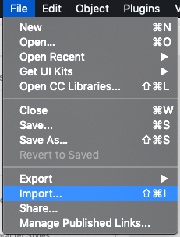
Importing images
To import image to your page choose ”File – Import”
Then browse to course material folder and choose ”car_background.jpeg”
This image has been downloaded from www.pexels.com

Slide 18
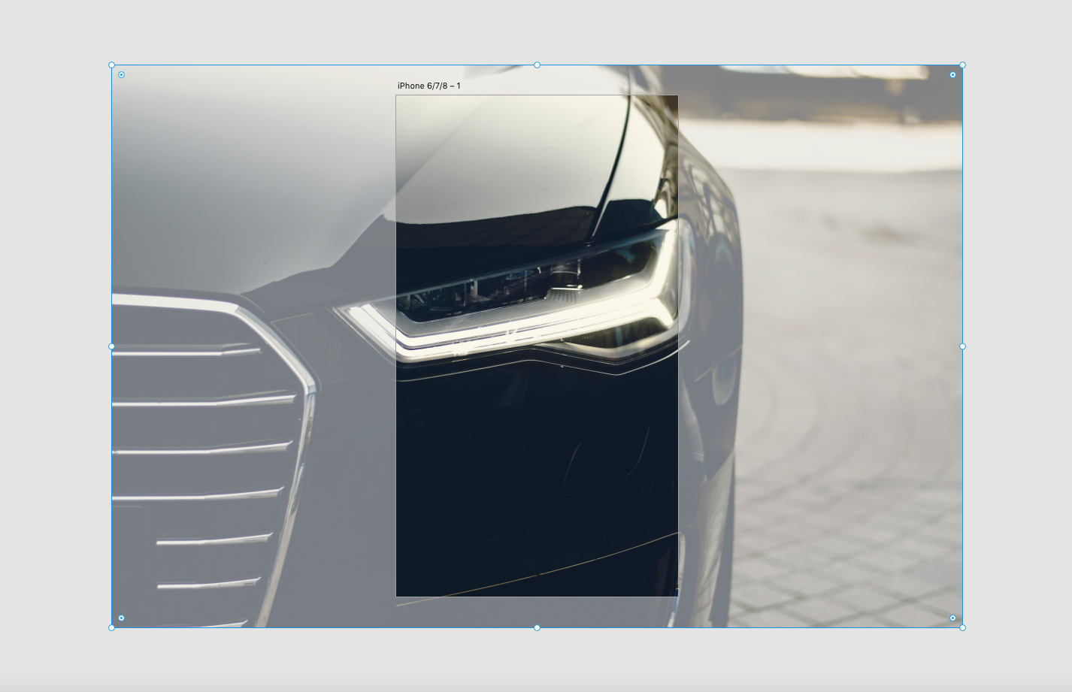
Importing images
Once image is downloaded it’s clearly too large for page
But if you click gray area of your workspace you will only see part that is visible on your page
However too large images are distracting so we need to mask this image to cover our page only

Slide 19

Masking images
To mask image choose rectangle too from left tools pane
Then draw rectangle to cover entire page
To draw rectangle press and hold left mouse button at top-left corner of page then drag to bottom-right corner
Rectangle tool

Slide 20
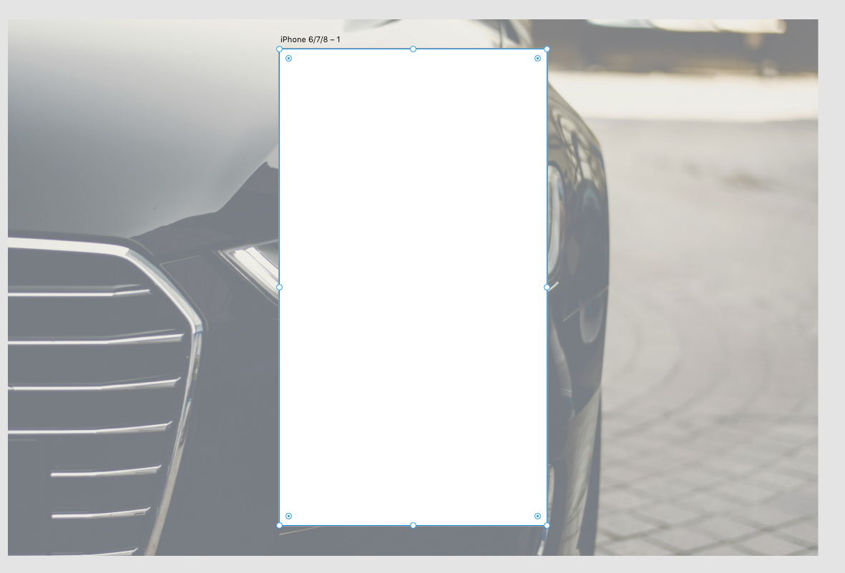
Masking images
Your page should look like this

Slide 21

Masking images
Now click ”Select tool”
And with ”Select”-tool click car image and then hold Shift key and click white rectangle. This chooses both elements.
As rectangle is on top of image we can use it to mask image to rectangles region.
Choose from menu ”Object – Mask with Shape”
Select tool

Slide 22
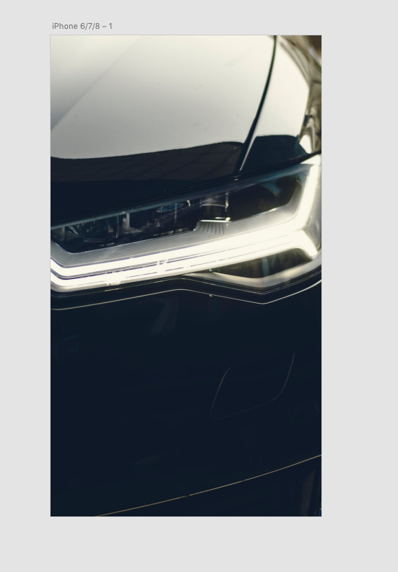
Masking images
This how your page should look now

Slide 23
Masking images
On next slide you will see video how to import and mask image

Slide 24
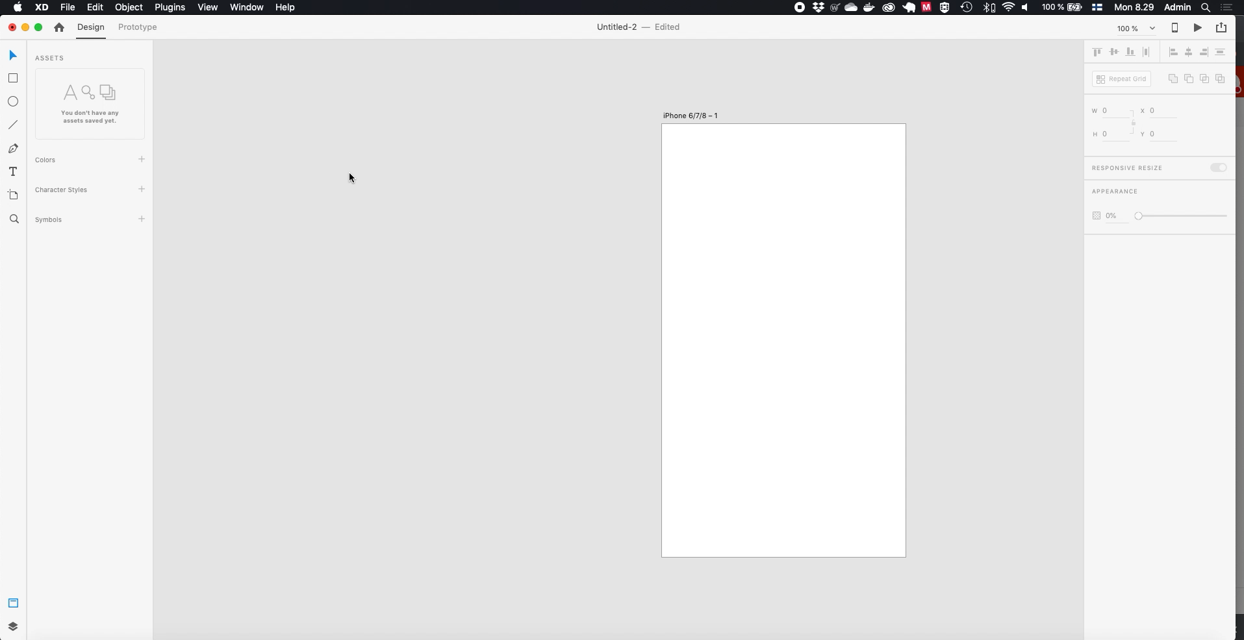

Slide 25
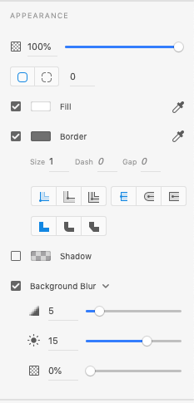
Blurring images
We can slightly blur our car image so that it doesn’t steal user attention. To do this create another rectangle on top of image.
Then select rectangle and choose Background blur from right pane.
First slider will modify blur amount, second one is brightness and third one opacity. We can use blur amount of 5 for now
Background blur

Slide 26
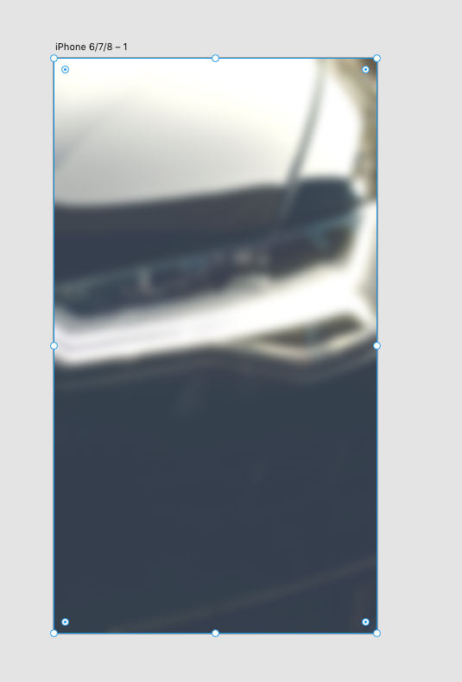
Blurring images
This how your page should look now

Slide 27
Blurring images
On next slide you will see video how to import and mask image

Slide 28
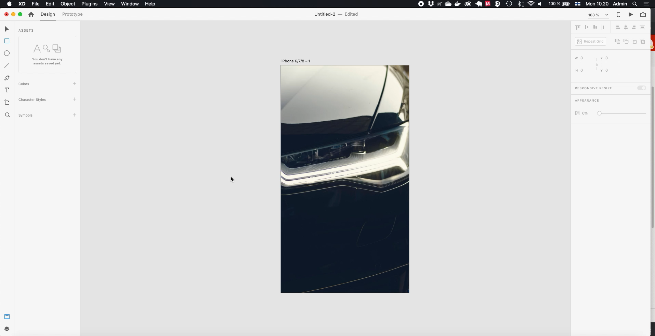

Slide 29
Royalty free images
There are lot of good places to aquire images for your protoypes, some of them are paid and some of them free
Most of the time you can get started with free ones, but as you do more prototypes you migh need to buy licences for images
Good roalty free images can be found from:
www.pexels.com
www.unsplas.com
www.pixabay.com
Remember to read copyright details for each images, as they are free to use they might require you to mention photographers name or some images can only be used in non-commercial purposes

Slide 30
Lesson 1
Now you should have knowledge of following
Creating of new design template
Import images to design page
Masking of image and blurring images

